Slide 1

ARCHITECTURE OVERVIEW

Slide 2

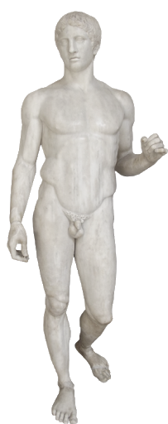

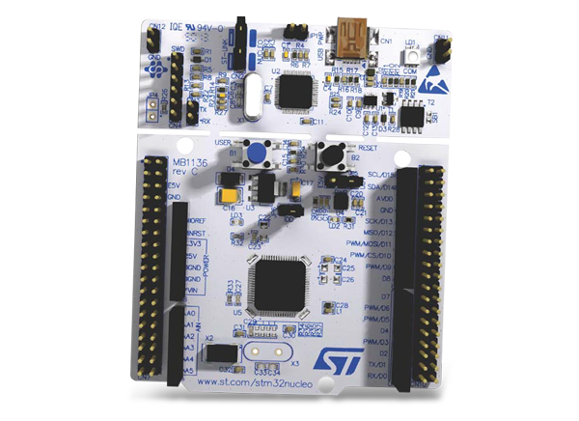



POSITIONING ARCHITECTURE
Server based positioning
The visitor has a tag that advertises their MAC address or UUID. The signal is catched by specific hardware and which is then transmitted to server for calculating and gathering statistics.

Slide 3









SOFTWARE
HARDWARE
Smartphone
Azure IoT Hub
STM-Nucleo
RIOT-OS
PROTOCOLS
App Service
MQTT
Azure ML
MQTT-SN
Sheets
BLE
Azure DB

Slide 4
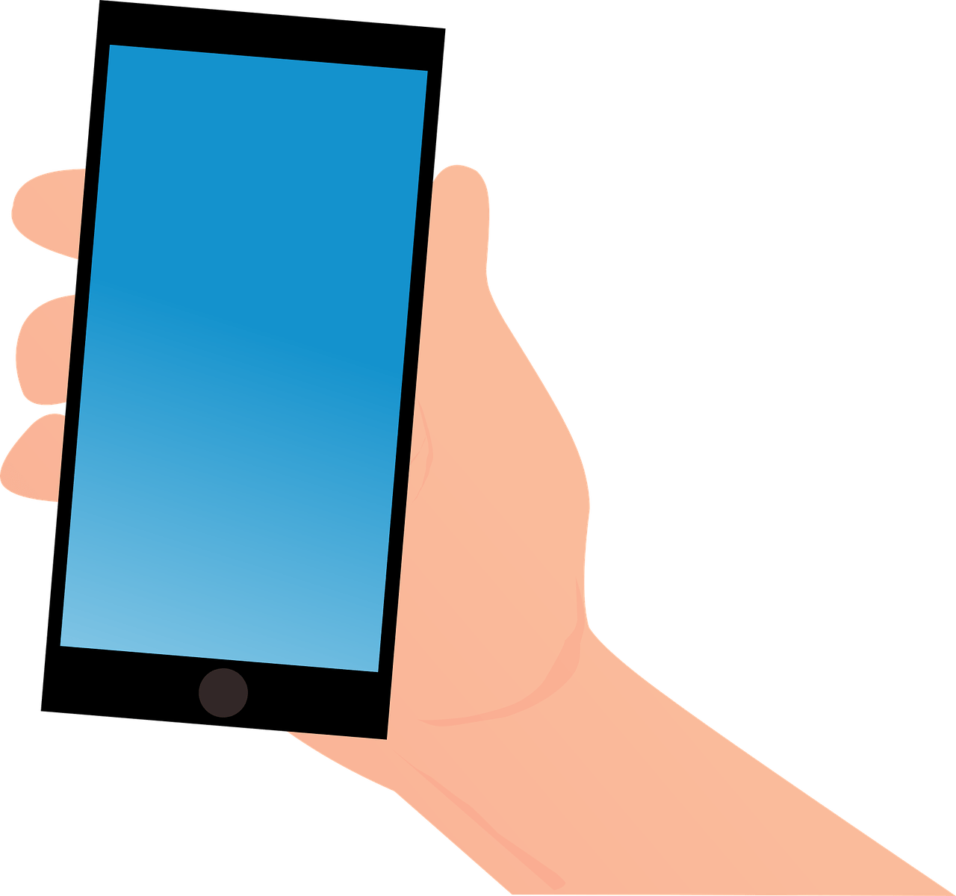
Azure IoT Hub
App Service
MQTT-SN
Azure DB
MQTT
MQTT-SN
Azure ML
Sheets

